Slide 1
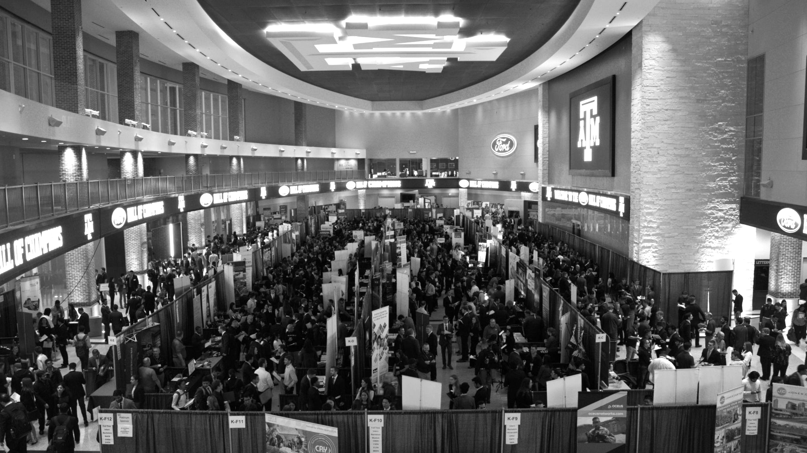

LANL Team Week 4 Project Update
2/5/2025
Izzy Baumler, Dalton Boeckmann, Morgan Gullo, Jade Waldron

Slide 2
Problem Statement/Project Motivation
There is a need for a technology that has 5 DOF and can move through its full range of motion in each degree of freedom of at least 1 Hz.

Slide 3
Weekly Assigned Tasks
Jade - Refinement of Solidworks Models/Prototyping
Izzy - Prototyping/Motor Research and testing
Dalton - Fastener BOM/Electrical Research
Morgan - Purchase Orders/Electrical Research

Slide 4
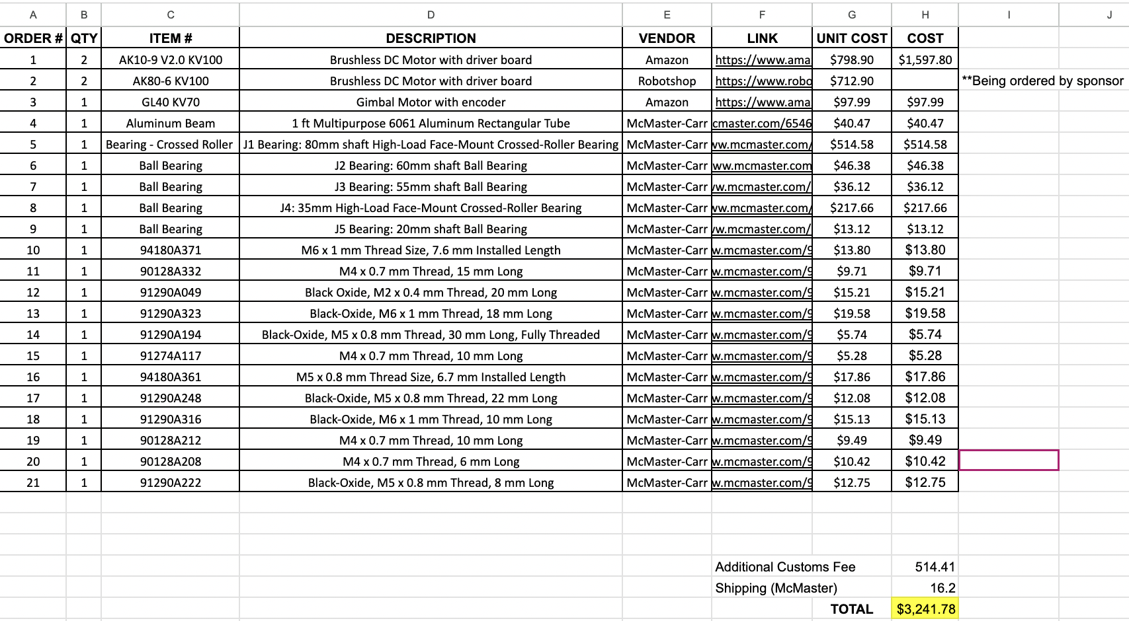
Budget Update

Slide 5
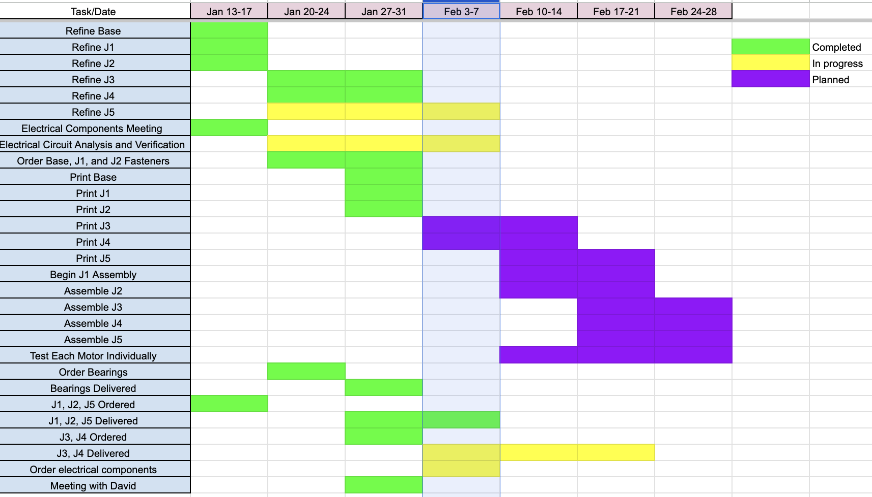
Schedule Update

Slide 6
Sponsor Meeting Takeaways
5-DOF Arm Confirmed: We will proceed with a 5-DOF arm design, simplifying integration and potential tool attachment.
Safety Enclosure: A 4x4x4 ft. safety cage will be implemented.
Sponsor Support:
J3 and J4 motors will be provided by the sponsor, reducing costs.
This allows for increased budget allocation to electrical and structural components.
The sponsor is also assisting in sourcing a suitable power supply.

Slide 7
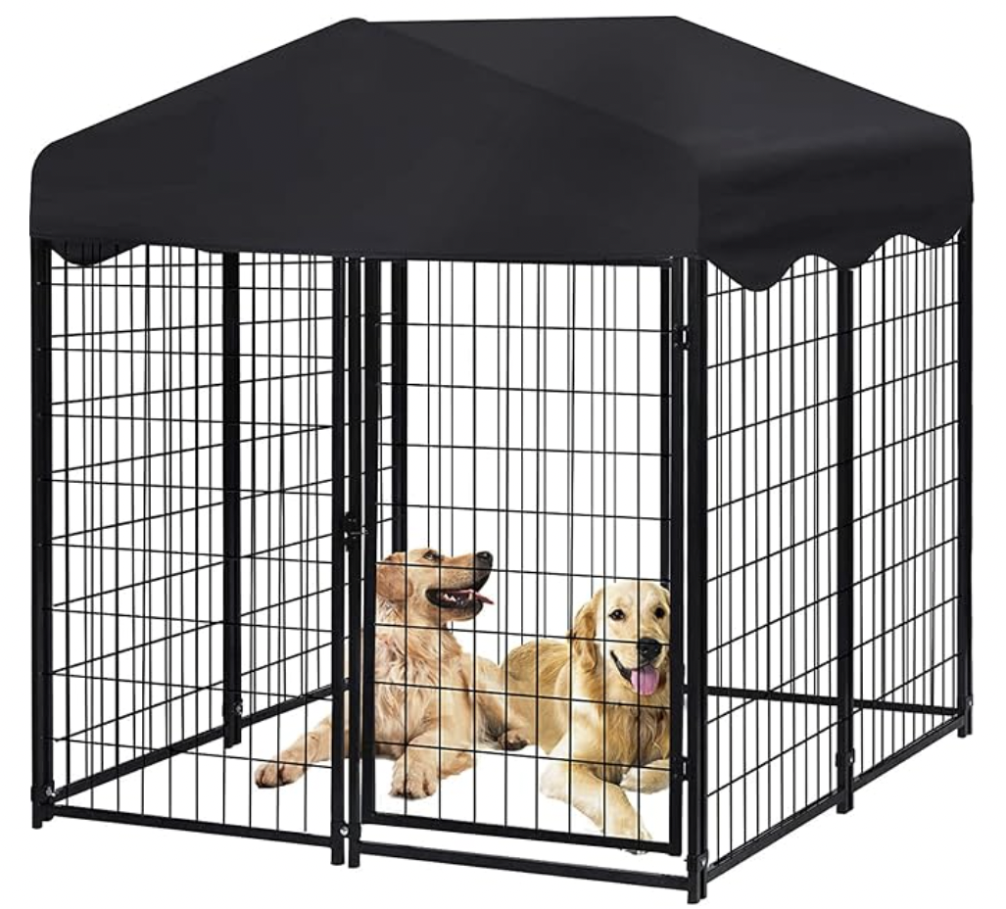
Safety Cage
Originally designed an industrial safety cage, but due to high cost, the sponsor suggested a dog cage, which I will order once approved

Slide 8
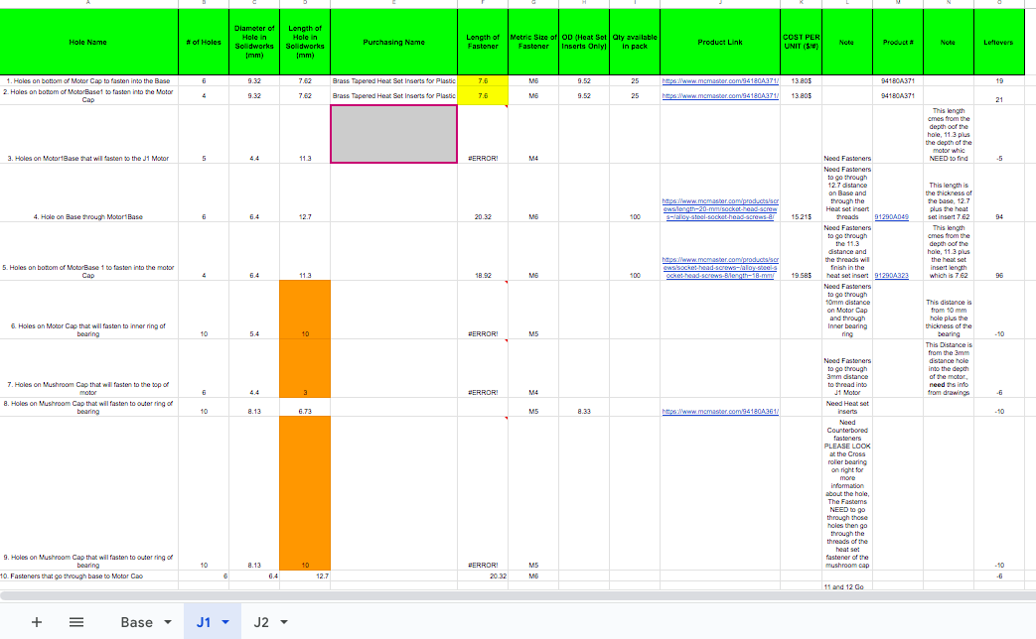
Fasteners
Finished and Ordered all J1, and J2 Fasteners
Total Cost (J1,J2): $147.5
J3, J4, and J5 are being done accordingly
Plan to test our heat set inserts on a mock PLA part when they arrive, to not damage our actual design

Slide 9
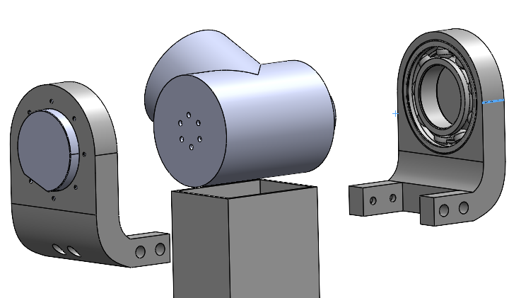
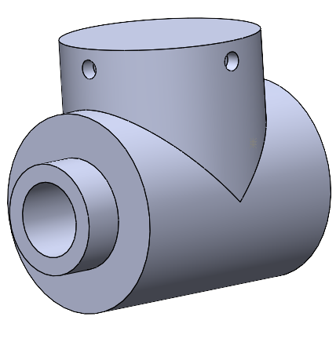
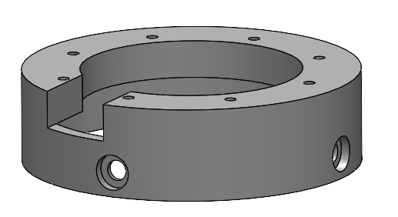
CAD Refinement
Having to increase sizes of holes for rest of arm due to tolerance issues with J1/J2 prototypes

Slide 10
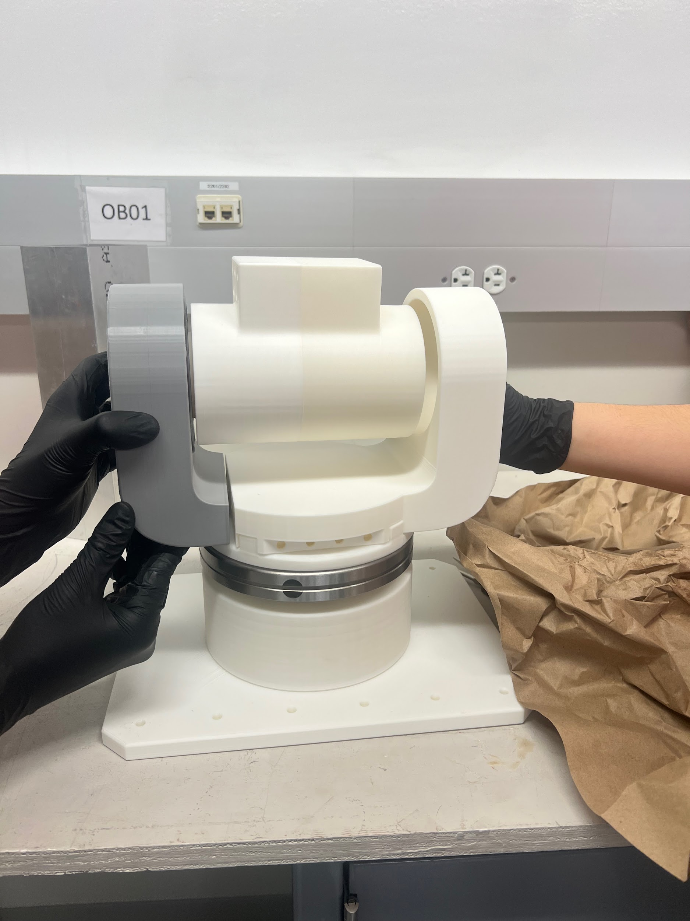
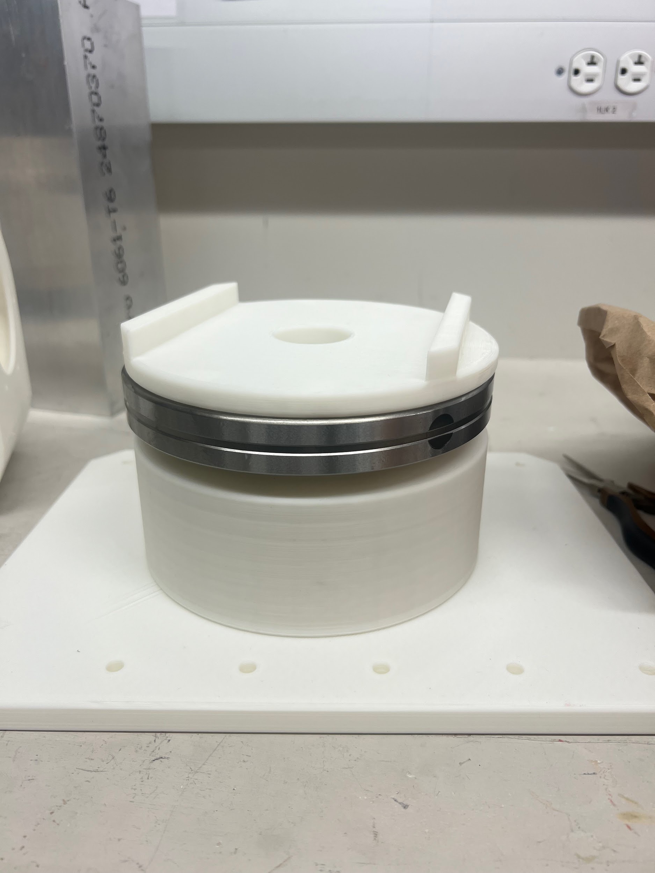
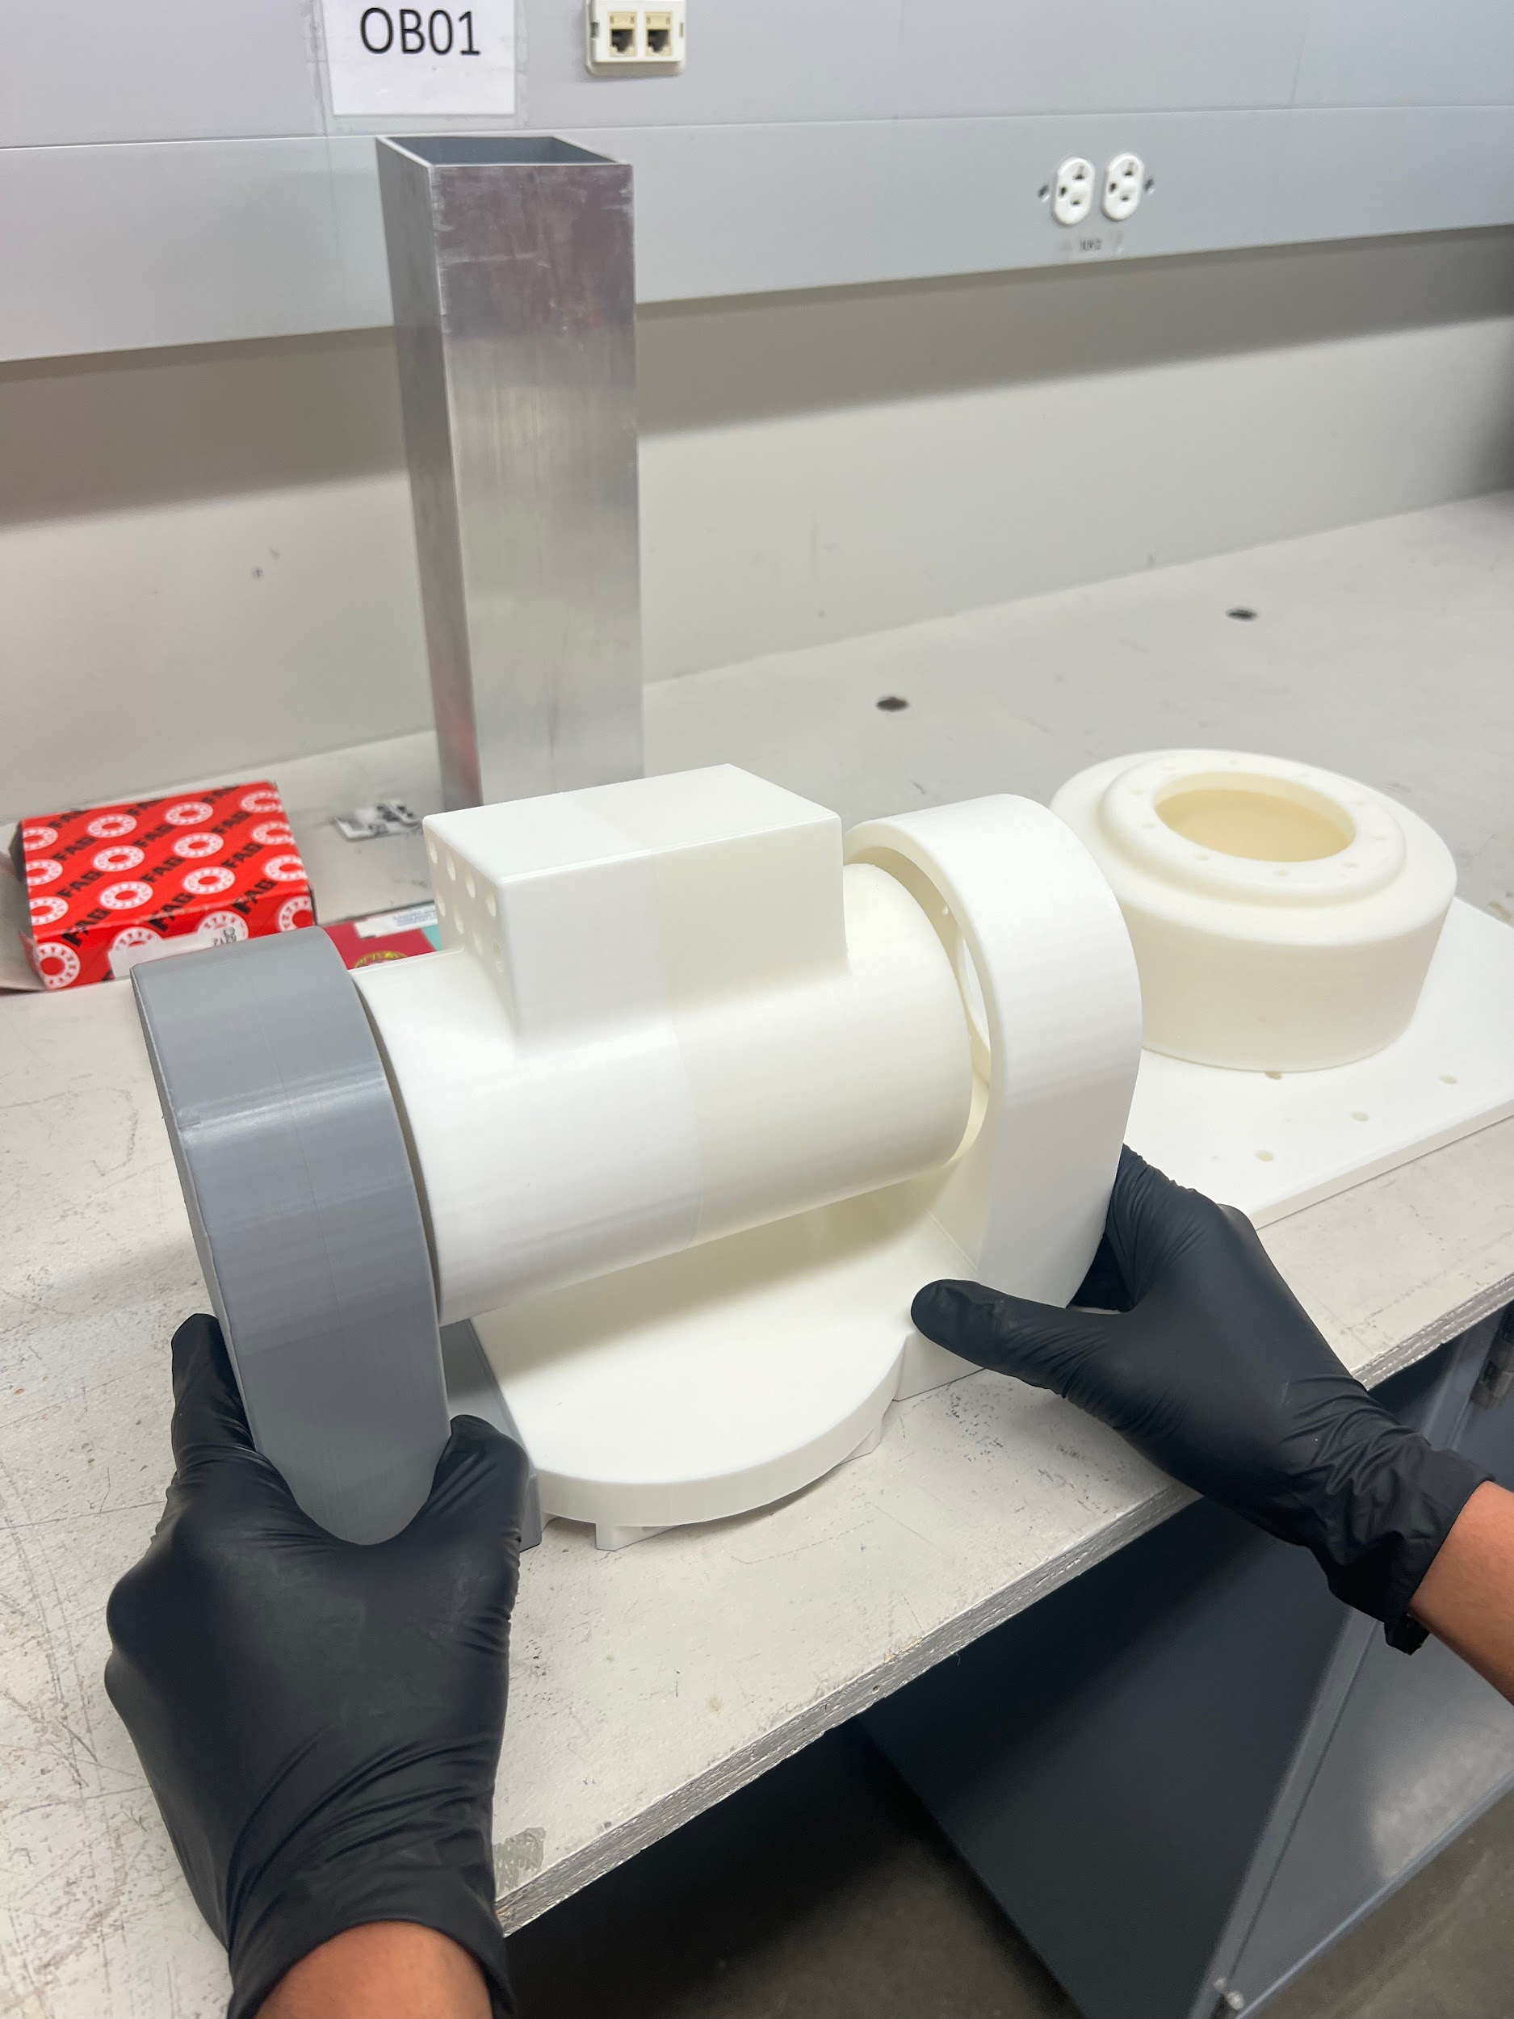
Prototyping

Slide 11
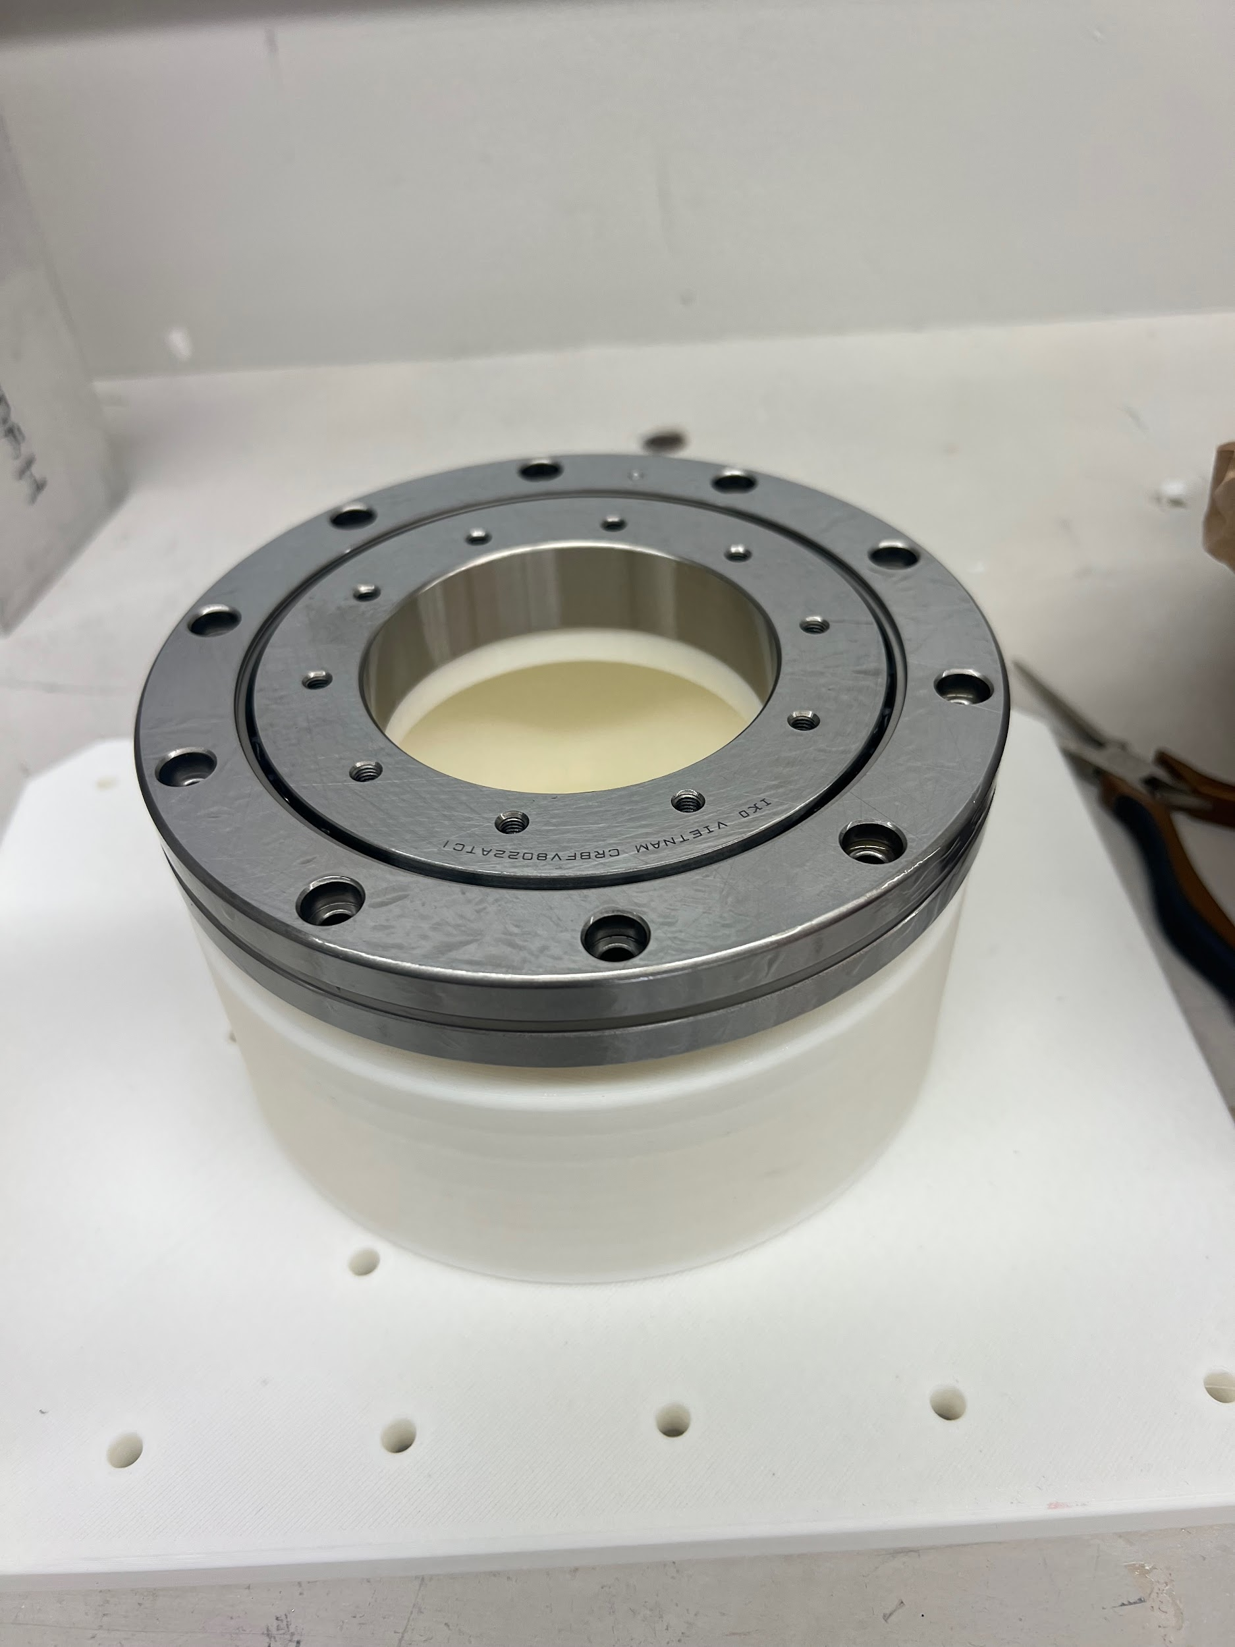
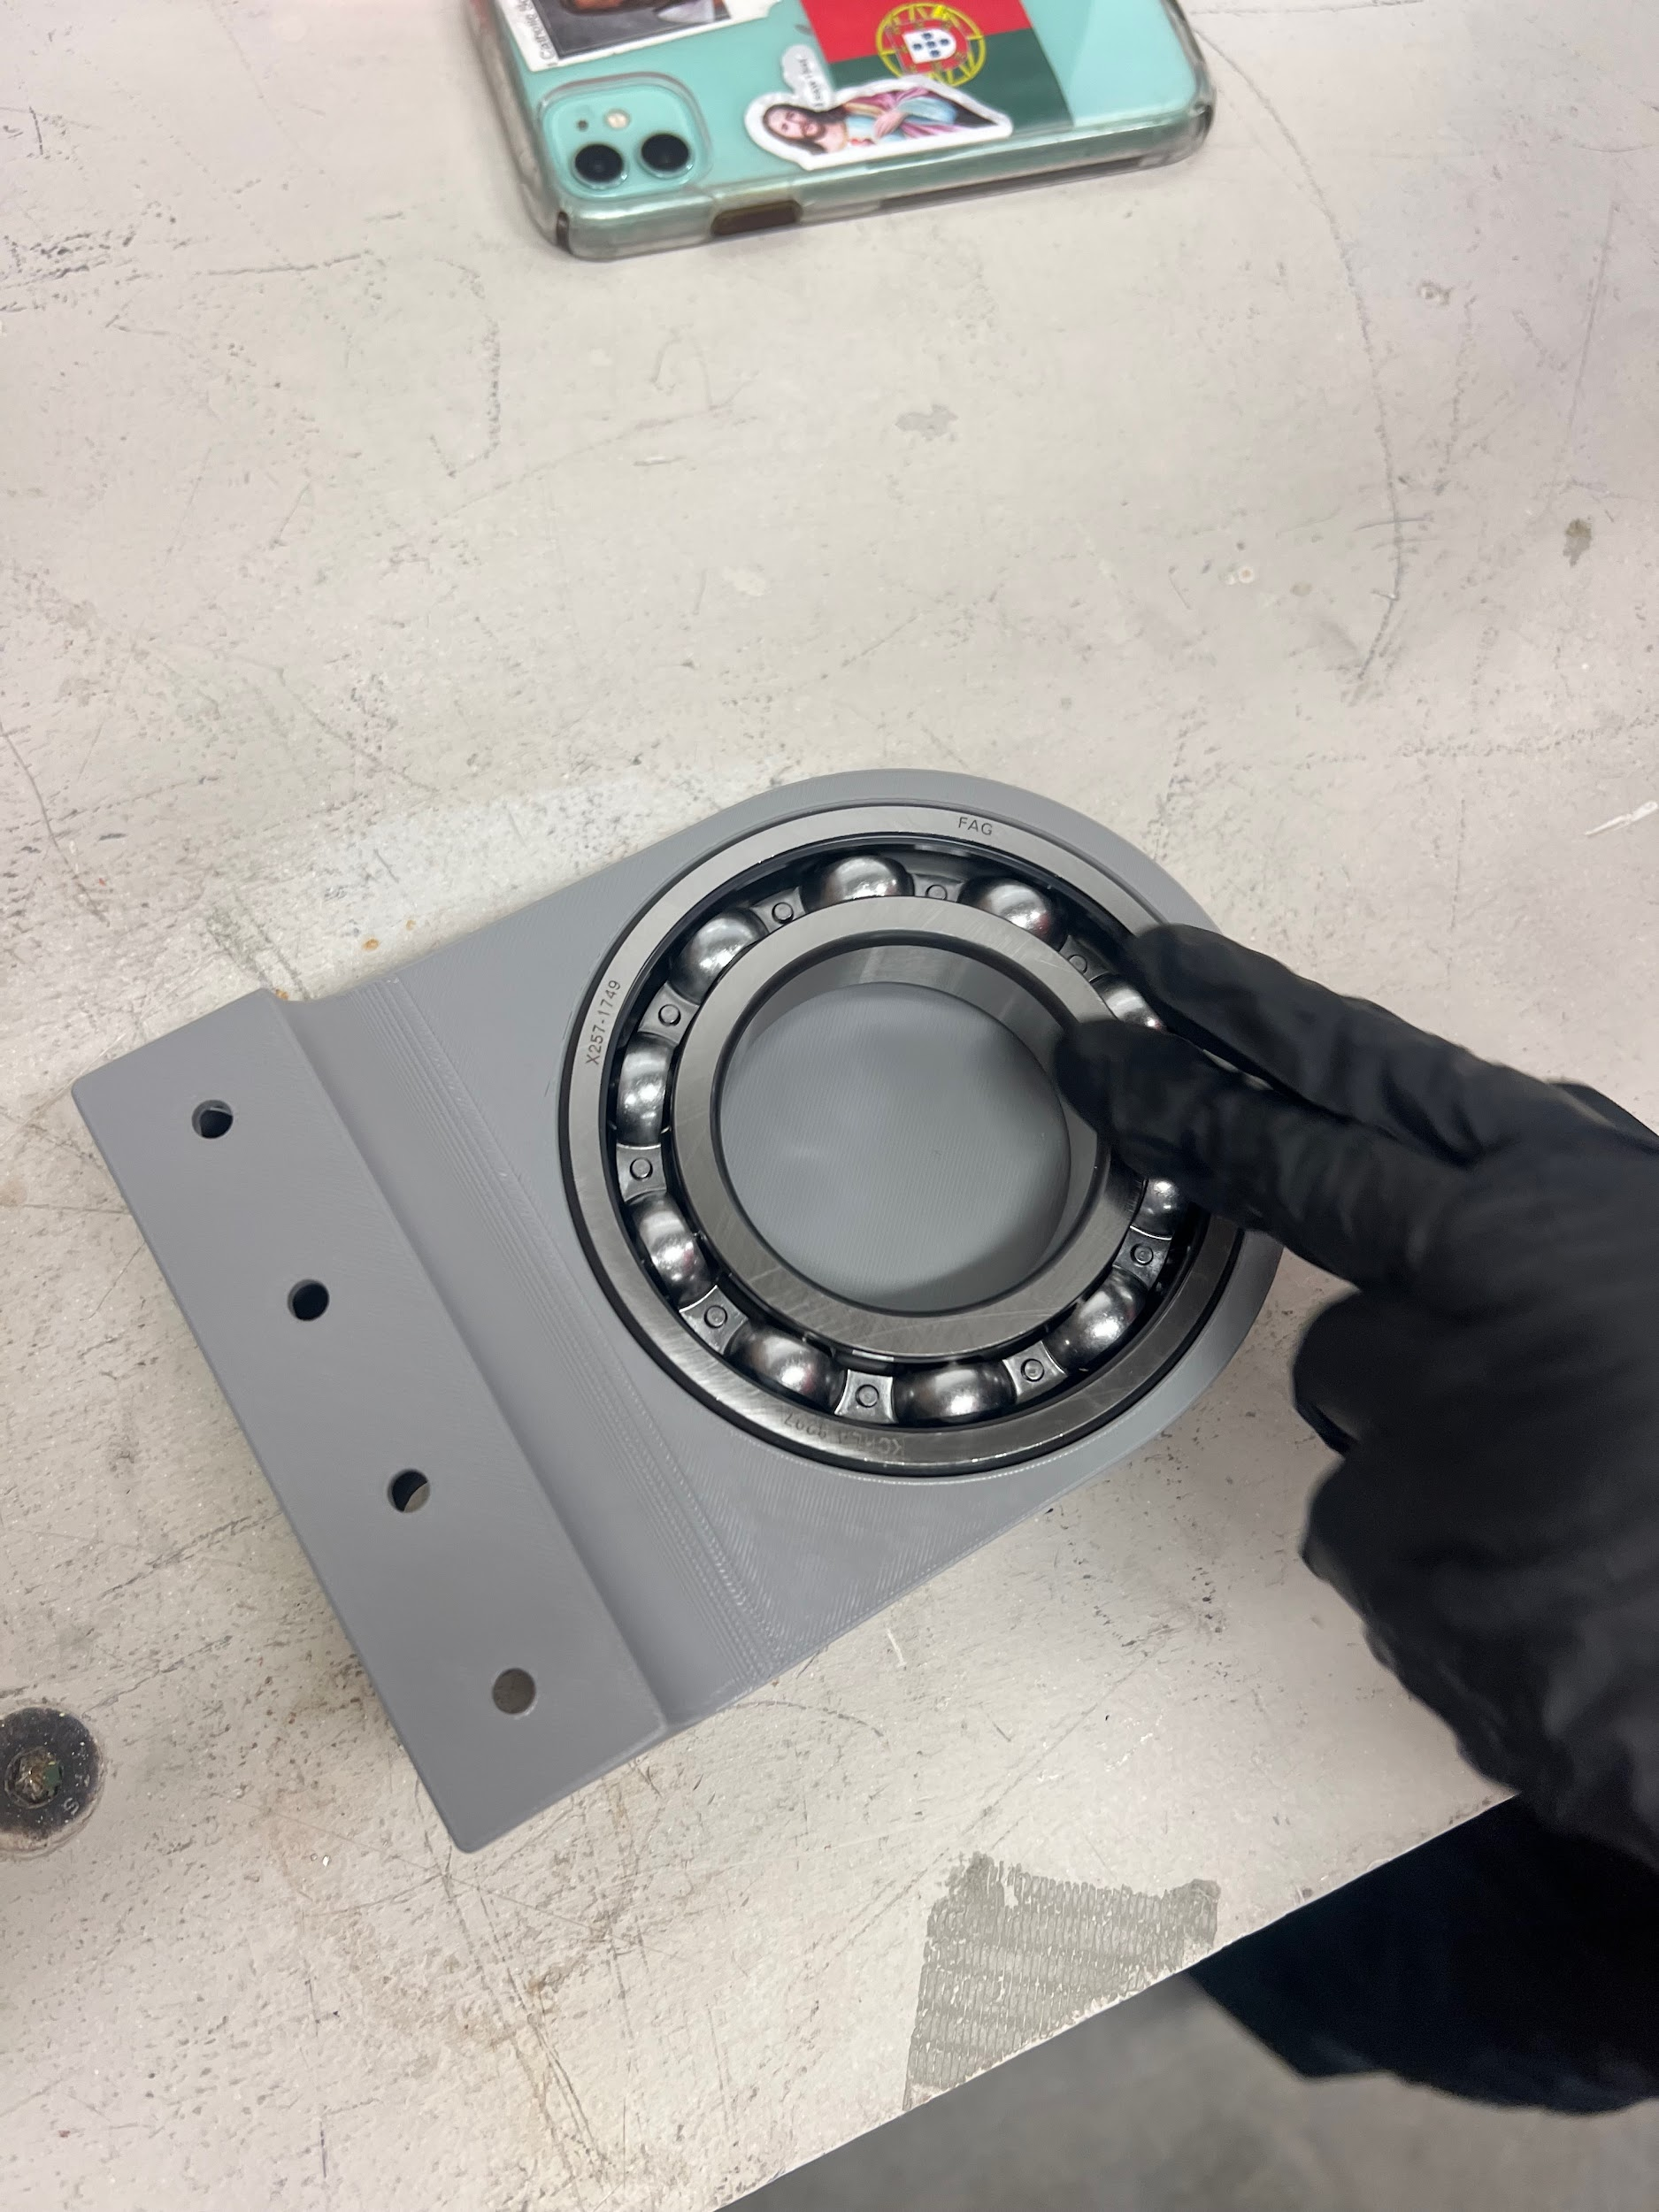
Prototyping

Slide 12
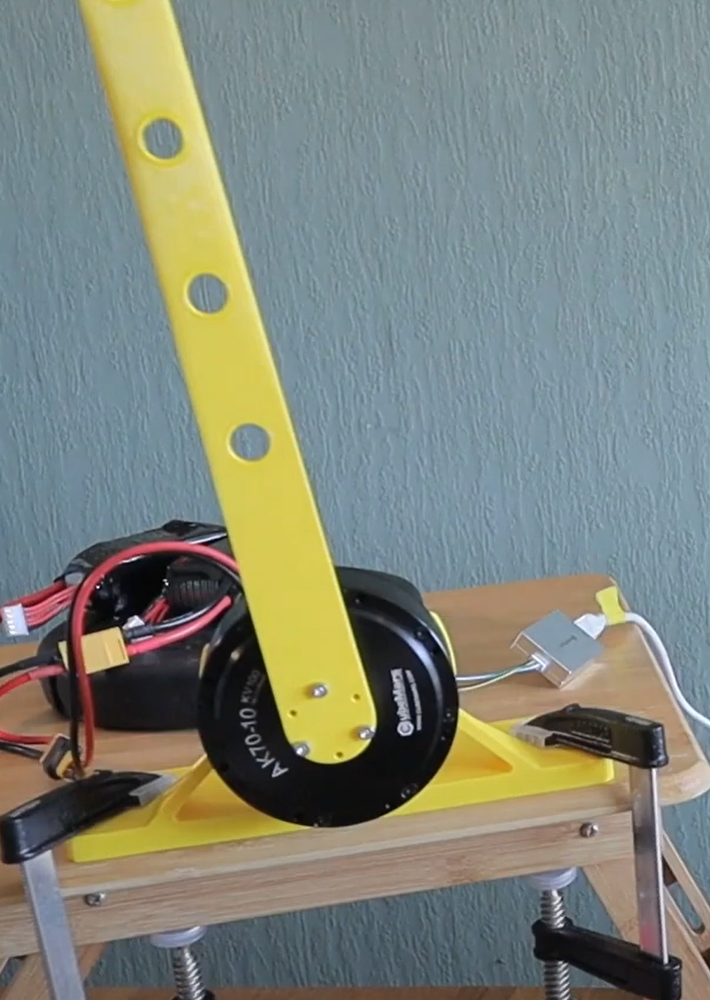
Motor Research
Testing Plan:
-Print out PLA to attach to motor
-Utilize software to test rotations in each motor
-Evaluate how motor determines position
-Ensure each motor is working before joint attachment

Slide 13
Future Assignments
Continue Selection Process with Fasteners and Ordering
Order electrical components
Begin assembling Base, J1, and J2
Print J3, J4, and J5
Begin midterm report/presentation

